Slide 1
How to Read Literature Like a Professor
By Thomas Foster
Notes:
This book attempts to identify key

Slide 2
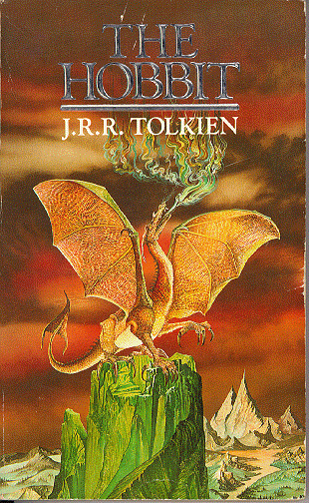
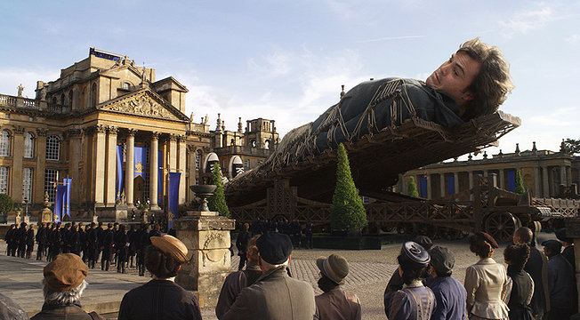
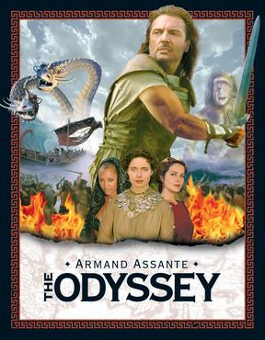
Every Trip is a Quest!

Slide 3
Eating: Acts of Communion
Whenever people eat together, it is a communion. This is not necessarily religious, but it is an act of sharing and peace.
A failed meal carries negative connotations.

Slide 4
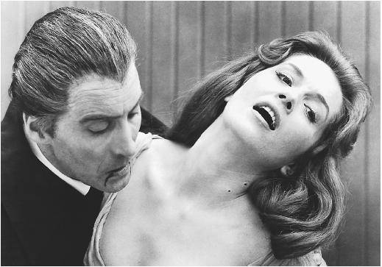
Eating: Vampires
Literal vampires are easy to spot. You don’t need a degree in literary theory to notice when one character sucks blood out of another character’s neck!
The subtext here is usually sexual. It is a trait of 19th century literature to address sex indirectly.
Symbolic vampirism is trickier. A character can be selfish, exploitive, and place his or her ugly desires above the needs of another.

Slide 5
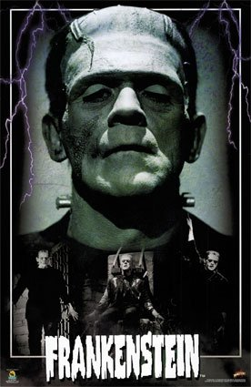
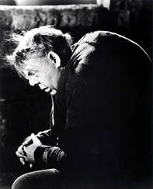
Monsters
Frankenstein – monster created through no fault of his own, the real monster is the creator
Faust – bargains with the devil in exchange for one’s soul
Dr. Jekyll and Mr. Hyde: the dual nature of humanity, in each of us there is evil
Quasimodo – the physical deformity reflects the opposite of the inner character

Slide 6
If it is a Square, It is a Sonnet!
My mistress' eyes are nothing like the sun; Coral is far more red than her lips' red; If snow be white, why then her breasts are dun; If hairs be wires, black wires grow on her head. I have seen roses damask'd, red and white, But no such roses see I in her cheeks; And in some perfumes is there more delight Than in the breath that from my mistress reeks. I love to hear her speak, yet well I know That music hath a far more pleasing sound; I grant I never saw a goddess go; My mistress, when she walks, treads on the ground: And yet, by heaven, I think my love as rare As any she belied with false compare.

Slide 7
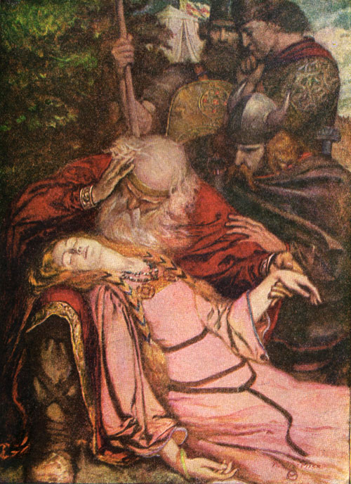
References: When in Doubt, It is from Shakespeare!
Hamlet: heroic character who seeks revenge, plagued by indecision, is melancholy.
Henry IV: a young man who must grow up to become king, must mature to accept his responsibilities.
Othello: jealousy is his downfall.
Merchant of Venice: theme of justice vs. mercy.
King Lear: aging parent, greedy children, a wise fool.

Slide 8
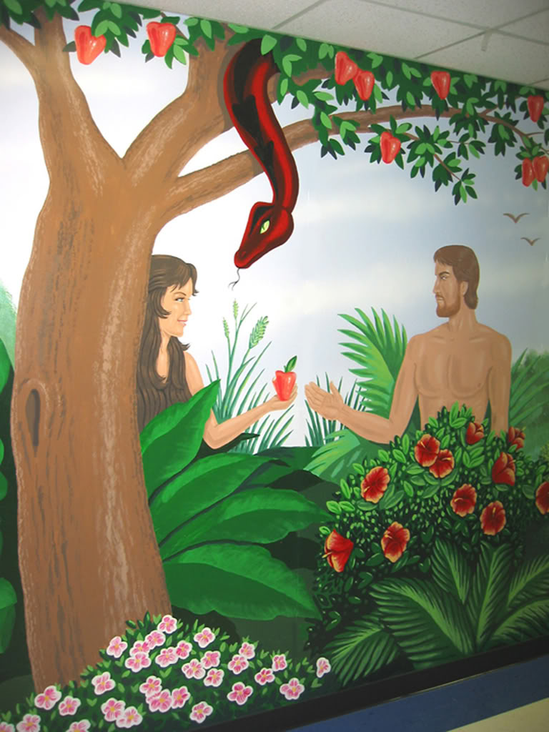
…Or the Bible!
Garden of Eden: women tempting men, the apple symbolizes temptation, serpent symbolizes evil, a fall from innocence
David and Goliath: overcoming great odds
Jonah and the Whale: refusing to face a task and being “eaten” or overwhelmed
Job: facing disasters not of the character’s making, suffering, but remaining steadfast
The flood: rain as a form of destruction
The Apocalypse: Four Horsemen usher in the end of the world
Biblical names

Slide 9
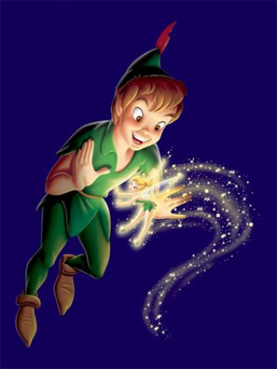
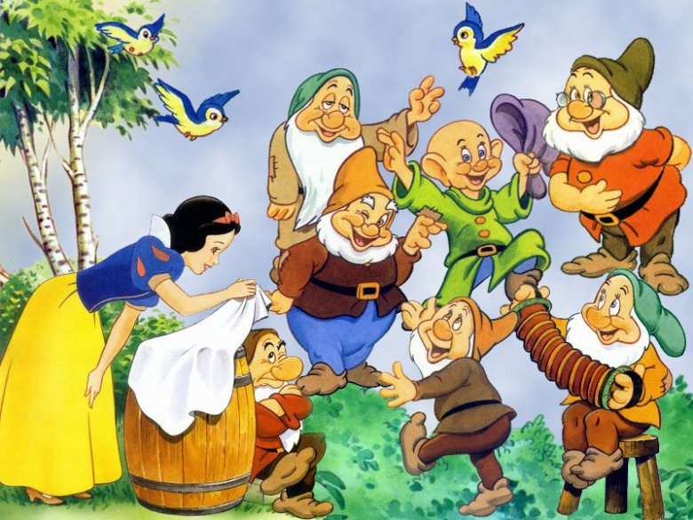
Fairy Tales
Hansel and Gretel: lost children trying to find their way home
Peter Pan: refusal to grow up, eternal youth
Little Red Riding Hood: connects to vampire imagery
Alice in Wonderland / Wizard of Oz: entering a world that doesn’t work rationally or operates under different rules
Cinderella: orphan abused by adopted family
Snow White: evil woman who brings death to the innocent
Sleeping Beauty: a girl becoming a woman, a long sleep or an avoidance of growing up, saved by a hero
Prince Charming: rescuer, interchangeable in fairy tales

Slide 10
It is Greek to Me
Odyssey and the Iliad: men in a struggle over a woman, heroic journey home mirrors one’s self discovery
Achilles: a small weakness in a strong man
Penelope: determination to remain faithful
Oedipus: dysfunctional family, being blinded
Cassandra: tells a truth nobody wants to hear

Slide 11
Weather
Rain
Fertility
Drowning
Misery
Dramatic element – occurs just as or before an important moment
Snow
Death
Paralysis
Isolation
Can be positive – holiday imagery

Slide 12
Is that a Symbol?
YES! But there is no definite meaning unless it is an allegory where characters directly match up to other things (characters in Animal Farm directly connect to the Russian Revolution)
Symbols have multiple meanings and are open to interpretation

Slide 13
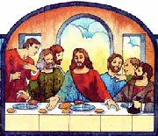
Christ Figures (Her Too!)
Wounds on hands and feet
Agony
Self-sacrificing
Loaves, fishes and wine
Carpenter
Walking on water
Confrontation of evil
Rising from the dead
Disciples
Forgiving

Slide 14
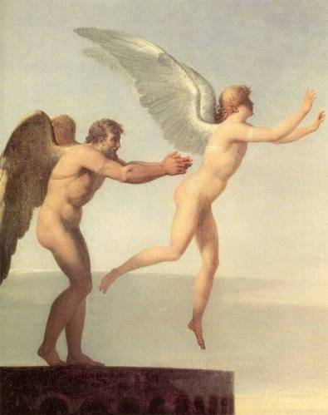
Flying
Can be dangerous – Dedalus and Icarus
Can also symbolize freedom

Slide 15
It is ALWAYS about Sex…
Look for images of fertility for women and masculinity for men
Sometimes coded sexual images can be more intense than literal ones
In the past, authors have had to write about sex indirectly in order to avoid censorship

Slide 16
…EXCEPT When It Is about Sex!
When authors write directly about sex, they’re writing about something else, such as sacrifice, submission, rebellion, domination, enlightenment, etc.

Slide 17
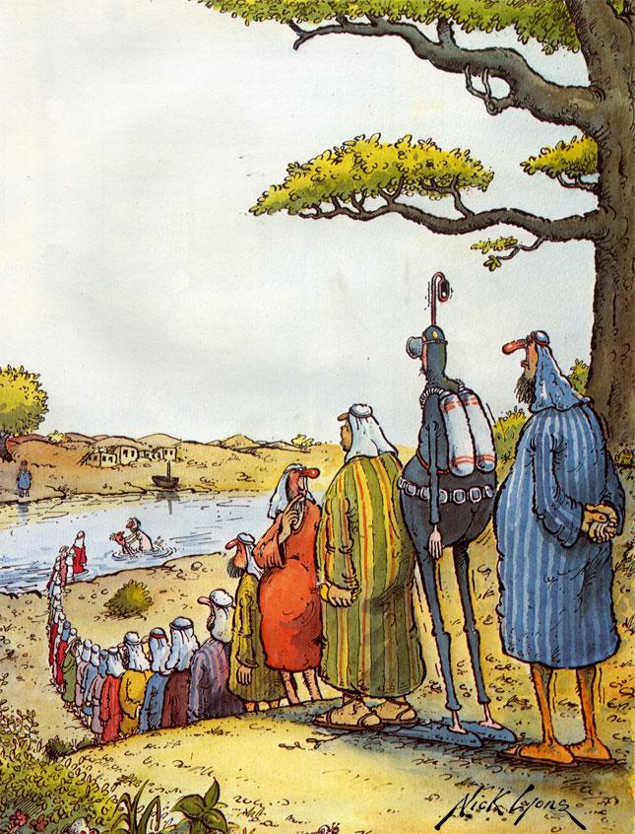
Water
Baptism is symbolic of death and rebirth into new life
Drowning is symbolic of baptism – IF the character comes up, symbolically reborn. But drowning can also represent a form of rebirth, choosing to enter a new, different life, leaving the old one behind.
Rain can also connect to baptism

Slide 18
‘Tis the Season!
Spring = fertility, life, happiness, growth, resurrection
Fall = harvest, reaping what we sow, both rewards and punishments
Winter = hibernation, lack of growth, death, punishment
Christmas = childhood, birth, hope, family
Look for irony! (“April is the cruelest month”)

Slide 19
He is Blind for a Reason!
Physical blindness mirrors moral, intellectual, or psychological blindness
Sometimes ironic – the blind can “see” the truth and the sighted can’t

Slide 20
Disease
Tuberculosis – a wasting disease, often associated with sexuality or passion (red blood coughed up is the sign)
Physical paralysis – mirrors moral, social, spiritual, intellectual, or political paralysis
Plague – Divine wrath, philosophical possibilities of suffering on a large scale, the isolation and despair created by destruction, the puniness of humanity in the face of an indifferent world
Malaria – means literally “bad air”
Venereal disease – reflects immorality OR innocence, when the innocent suffer because of another immorality
Fever – mysteriously carries off victims
Cancer – festers inside and worsens as it spreads, gnaws away at the victim, often mirrors the emotional state
AIDS – modern plague, tendency to be dormant for years, victims are unknowing carriers of death, disproportionately hits the young and the poor.

Slide 21
Is He Serious?
Irony is the most important device to look for
Failing to observe an ironic moment in literature will often lead to a COMPLETE MISUNDERSTANDING of the author’s intent.

Slide 22
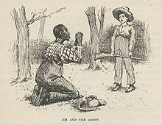
How Do I Spot Irony?
Look for the unexpected or surprising –
In Waiting for Godot two men stand beside the side of a road and yet they never take a step. Also, “Godot” never shows up
In the movie The Social Network Mark Zuckerberg, the creator of facebook, has millions of “friends” on facebook but no actual friends in life
Huckleberry Finn repeats racist language that he was raised hearing but acts with kindness and compassion to Jim, a runaway slave

